Slide 1
Candidate Briefing
Hosted by

Slide 2
Welcome
Cr Karen Chappel, AM JP
WALGA President
Acknowledgement of Country

Slide 3
Pictured left: Artwork by Jade Dolman, a young Whadjuk/Ballardong Nyoongar, Eastern Arrernte, Irish woman from Perth.

Slide 4
Program
The Importance of Local Government
Why being an Elected Member is important
Election Process – WA Electoral Commission
The Role of the Department of Local Government, Sport & Cultural Industries
The role of an Elected Member
Questions and Answers
Notes:
When considering roles and responsibilities it is important to bear in mind that the Local Government Act was created with separate powers in mind. We see this intent in the following reading speech extract when the current Act was read into Parliament << CLICK >>
The new Act will provide a clear distinction between the representative and policy making role of the elected Councillors and the administrative and advisory role of the Chief Executive Officer and other staff
CLICK
We will now look at how the Act was quite deliberately written with distinct roles for the Council, represented by Council Members, and roles for the Administration led by the CEO.

Slide 5
Hon David Michael Minister for Ports; Local Government; Road Safety, Minister assisting the Minister for Transport
The Importance of Local Government in Western Australia

Slide 6
Cr Karen Chappel, AM JP WA Local Government Association President
The importance of being an Elected Member in our communities

Slide 7
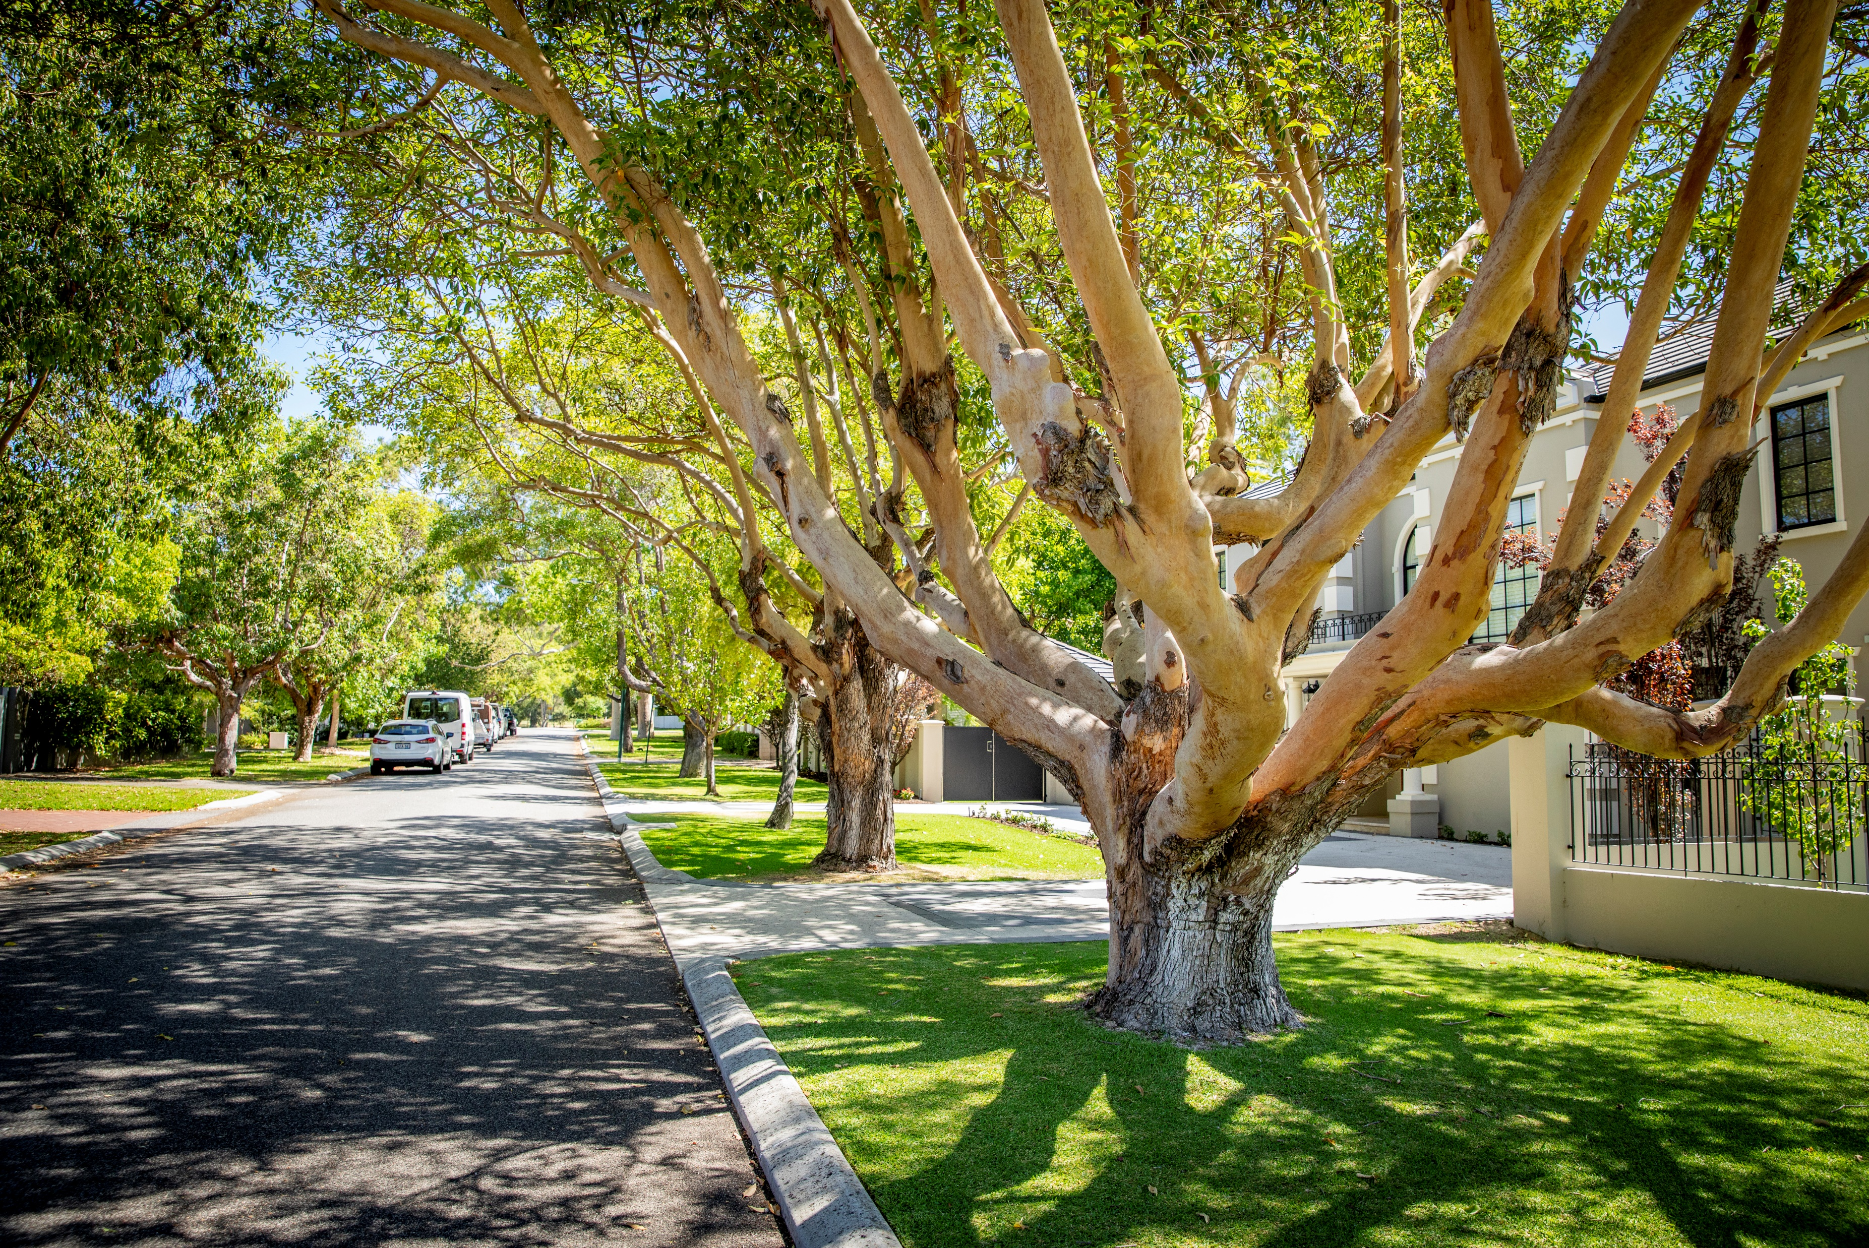
Robert Kennedy WA Electoral Commissioner
Process and key dates on running to become a Local Government Councillor in 2023

Slide 8
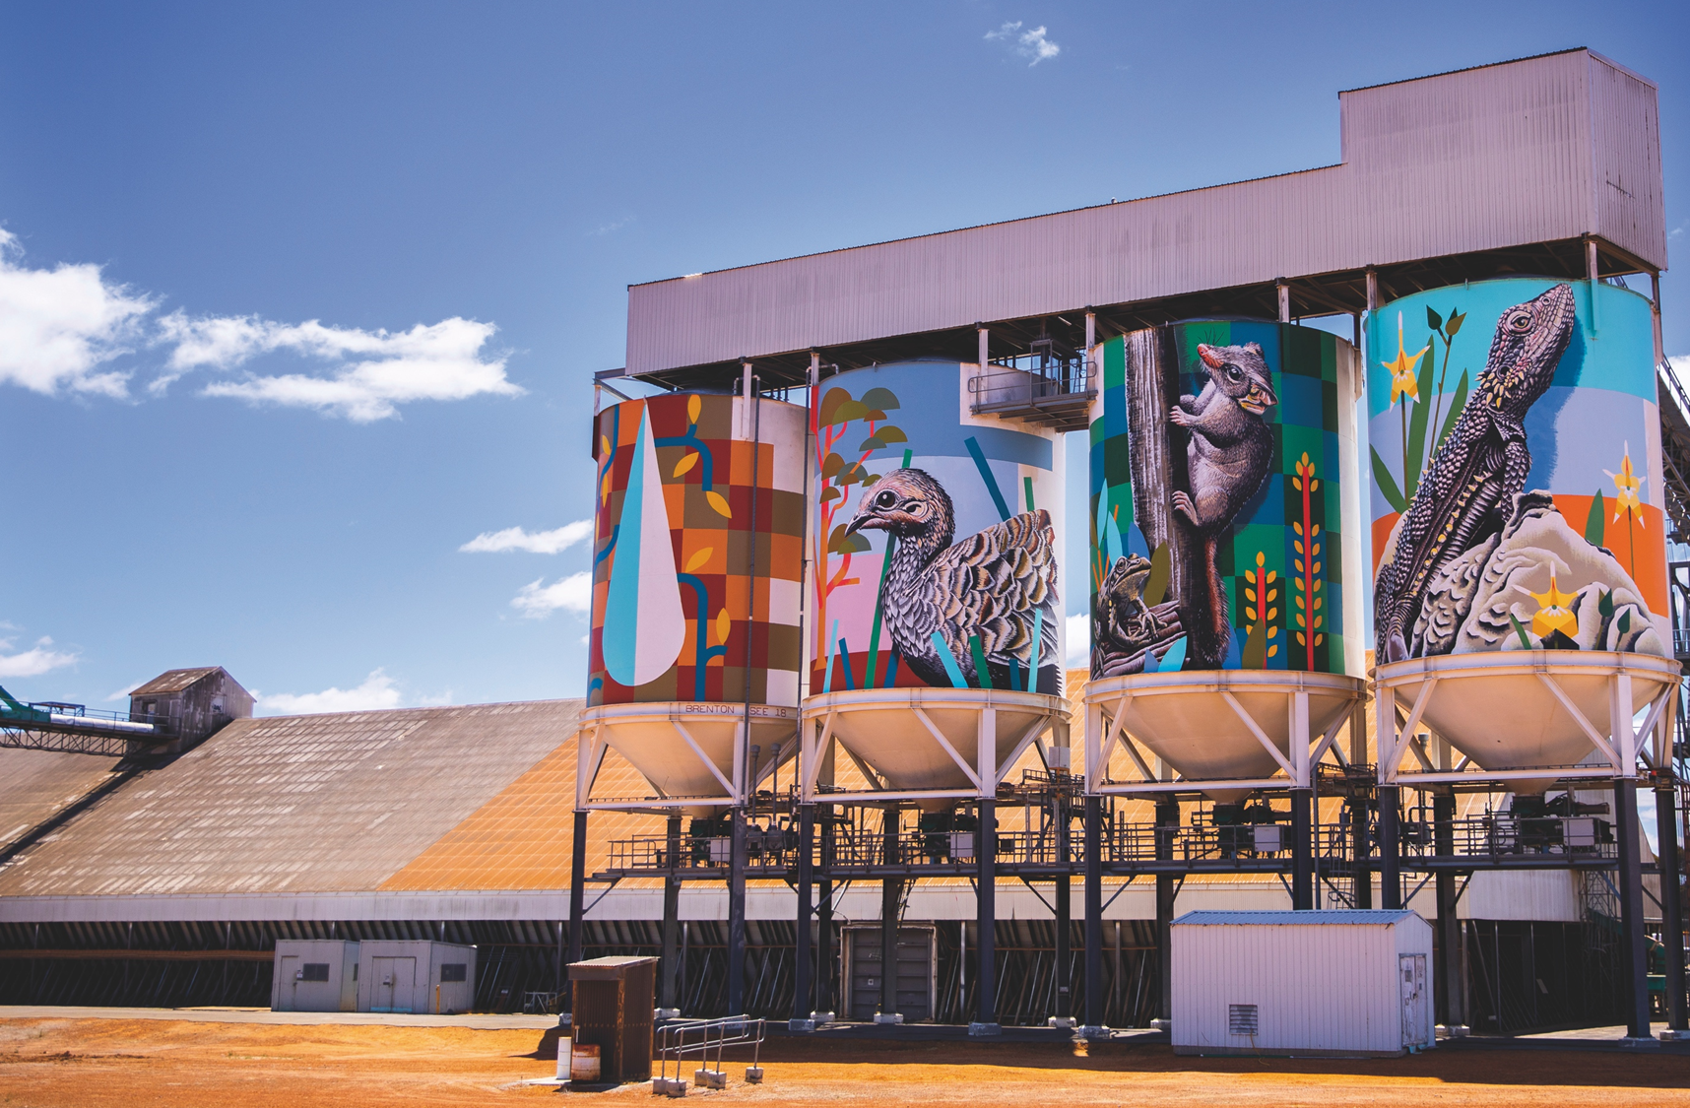
Phil Richards Manager of Election Events Western Australian Electoral Commision

Slide 9
2023 LOCAL GOVERNMENT ORDINARY ELECTION 21 OCTOBER 2023

Slide 10
WAEC KEY CONTACT
Returning Officer
One per local government
Conducts election on behalf of WAEC or local government
First point of contact with questions or complaints
Notes:
The returning officer is your key contact point if you nominate. They are the person authorised to conduct the election. If WAEC are running the election we appoint our own Returning Officers. If the local government is running the election they appoint a Returning Officer (generally the CEO).
Returning officer will
take your nomination
Answer your questions
Try to resolve simple complaints
Supervise the count
Decide if ballot papers are formal or informal
Authorise a recount
Declare the result
Please make use of them – they are there to help you but also make sure the election follows the rules.

Slide 11
WHO CAN NOMINATE?
18 years or older
Enrolled as an elector of the district
Cannot be a nominee of body corporate
Must have completed the mandatory course Local Government Candidate Induction- available on DLGSC website
Cannot be a candidate in another election for councillor
Notes:
Nominating for Election Qualification for election to council
Section 2.19 of Local Government Act 1995
18 or over (section 2.19(1))
As an elector must be on either the residents roll or if on the owner/occupier roll not as a nominee of a body corporate or Schedule 9.3
Must have completed the mandatory course Induction for prospective candidates located on the Department of Local Government, Sport and Cultural Industries official website.
Not a candidate in another election for councillor (Can nominate for both Mayor/President and Councillor if there is a mayoral/presidential election).

Slide 12
WHO CANNOT NOMINATE?
A member of parliament
An insolvent under administration
Convicted of a crime and in prison serving a sentence for that crime
Convicted in the preceding 5 years of a serious local government offence
Have been convicted of an offence for which the penalty was imprisonment for more than 5 years
An elected member of another local government
Misapplication of funds or property
Notes:
Nominating for Election Disqualifications for membership
Is not a member of either State of Federal parliament (Section 2.20)
Is an insolvent under administration within the meaning of the Corporations Act 2001 of the Commonwealth (Section 2.21).
Convicted of a crime and in prison serving a sentence for that crime (section 2.22 (1) (a)).
Convicted in the preceding 5 years of a serious local government offence (Section 2.22 (1) (b)).
Convicted of an offence for which the penalty was imprisonment for more than 5 years (Section 2.22 (1) (c)).
An elected member of another local government (section 2.23)
Disqualified because of misapplication of funds or property (section 2.24)

Slide 13
AN EFFECTIVE NOMINATION
Completed and signed nomination form (including reference number & date of completion of the on-line candidate induction)
Completed Candidate profile
Deposit $100 cash. Can be EFT as long as it is credited to the local government before the close of nominations
Additional Written statement containing information that the candidate considers relevant to their candidature (optional)
Received by the Returning Officer before the close of nominations
Notes:
Nominating for Election: An effective nomination
What is needed to make an effective nomination
Completed the course titled Induction for prospective candidates located on the Department of local government’s official website. Printout acknowledgement email which provides reference number & date of completion.
Completed nomination form (including providing reference number & date of completion of on-line candidate induction).
Candidate profile
Deposit $100 (cash, money order, bank cheque or credit card)
Can also be EFT as long as it is credited to the local government before the close of nominations
Additional information that a candidate considers relevant to their candidature (optional)
Received by Returning Officer before close of nominations

Slide 14
ONLINE WAEC NOMINATION BUILDER
Online nomination builder available from www.elections.wa.gov.au
You can prepare the nomination form, profile and upload photograph online
You cannot nominate online
Provide nomination ID at Returning Officer interview when submitting nomination
Nomination Builder available by 18 August 2023
Notes:
Nominating for Election
WAEC has created an online platform called Nomination Builder which allows candidates to prepare their nomination form, profile and upload their photo online.
You can’t nominate online however
This will allow the WAEC to stream line the information direct to the printer
It ensures your information is printed as it was written.
Provide the nomination ID to the Returning Officer when you meet with the Returning Officer to lodge your nomination.
Nomination builder available by 18 August 2023

Slide 15
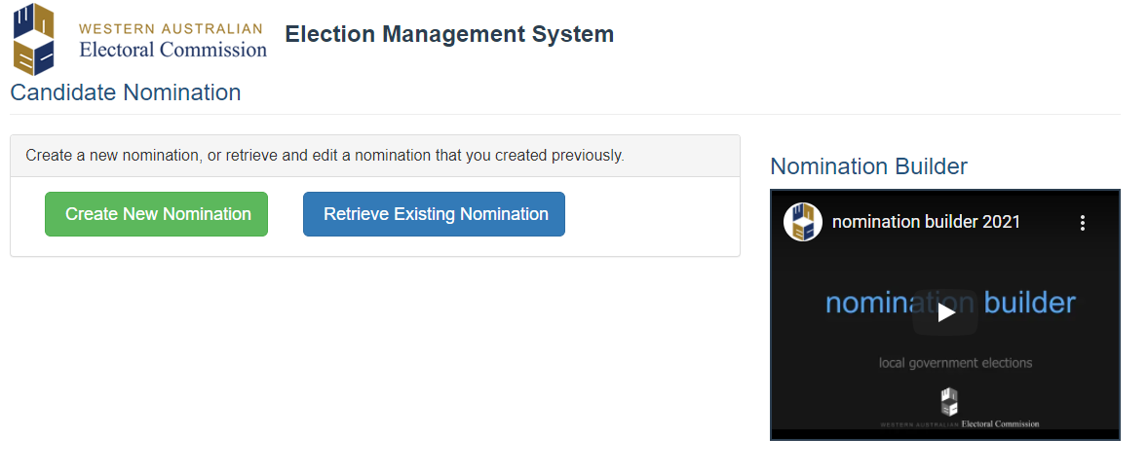
NOMINATING FOR ELECTION ONLINE WAEC NOMINATION BUILDER
Notes:
Nominating for Election
Candidate reviews and prints form
Confirms that they have:
1. Reviewed the contents of the form above & ensured that all entered information is correct
Performed a character count on your profile text to ensure that it contains no more than 1,000 characters (including spaces)
Reviewed the profile text, contact details and photograph both within the form, as well as on the noticeboard page to ensure It appears as you would like
Printed the page ready to sign and submit to the Returning Officer before the close of nominations
Candidate uploads a photo jpeg file
(less than 10 mb in size & 20 meg pixel)
Candidate sizes and crops photo.
Candidate enters text of profile for A4 notice to be published on LG Website.
In addition shows profile layout for election package

Slide 16
CANDIDATE PROFILE
Sent out with postal voting packages and posted on council website
Written in English – limit of 1,000 characters including spaces
Is to Contain:
Biographical information about the candidate
Statement of candidate’s policies or beliefs
Cannot contain:
information that the RO considers to be false, misleading or defamatory
Passport size recent photograph, head or head and shoulders (optional)
Notes:
Nominating for Election Profile
in English
Not more than 1,000 characters including spaces
Biographical information about the candidate
Statement of candidate’s policies or beliefs
Not to contain information that the RO considers to be false, misleading or defamatory
Passport sized Photograph (optional) of the candidate (head or head and shoulders) Not less than 6 months old or if the RO considers the photo shows a reasonable likeness of the candidate
At least one personal contact point – email, phone, address

Slide 17
ADDITIONAL RELEVANT INFORMATION
Optional
Written in English and limit of 2,000 characters including spaces
Accompany the candidate’s nomination paper
Not to contain any information that the Returning Officer considers false, misleading or defamatory
Can not use Nomination Builder to prepare
For publication on the Council’s website
Notes:
Nominating for Election Additional Relevant Information
Optional
in the English language
Not more than 2,000 characters
Additional information that a candidate considers relevant to their candidature
Not to contain any information that the Returning Officer considers to be false, misleading or defamatory
Can not use Nomination Builder to prepare
Will be placed on the local governments website (not included in election package)

Slide 18
ELECTORAL ROLLS
Free to candidates for campaigning purposes
1 Residents Roll and 1 Owners and Occupiers Roll
(for the ward or district they are contesting)
Destruction and deletion of copies of rolls
Offences for misuse of roll
Notes:
Electoral Rolls
Available on nomination for ward or district they are contesting. Mayoral candidate entitled to whole district roll
Free to all candidates and members (on request)
1 copy of Residents’ Roll
1 copy of Owners’ and Occupiers’ Roll
Destruction and deletion of copies of rolls
A recipient must before the end of the relevant period provide to either the Electoral Commissioner or CEO a statutory declaration confirming that every supplied copy has been destroyed or permanently deleted from any computer, device or medium or other storage system.
Relevant period
Candidate not elected – 5 working days after result of election is declared
Candidate elected – 5 working days after the term of office ends or the office becomes vacant
Member not a candidate – the term of the members current office ends or the office becomes vacant
Statutory declaration must:
Identify the election
Include a description of every supplied copy including whether the supplied copy was in electronic form
In relation to every supplied copy - the steps described taken to destroy it or to delete it permanently
Penalty
A fine of $5,000;
A daily penalty of a fine of $50 for each day or part of during which the offence continues

Slide 19
POSTAL VOTING MAIL-OUT OF PACKAGES
Lodged by WAEC with Australia Post:
From Friday 15 September 2023 (Country Local Governments)
From Wednesday 20 September 2023 (Metropolitan Local Governments)
Maximise campaigning around the delivery of the election packages
Notes:
Postal Voting Mail-out of packages
Election packages to be lodged with Australia Post on for delivery commencing on Friday 15 September 2023 (Country Local Governments).
Election packages to be lodged with Australia Post on for delivery commencing on Wednesday 20 September 2023 (Metropolitan Local Governments).
Candidates should maximise their campaigning around the delivery of the election packages

Slide 20
POSTAL VOTING RETURN OF VOTING PACKAGES
Packages can be posted to the Returning Officer using the supplied reply paid envelope or hand-delivered to the local government office
Numbers returned to WAEC posted on the Commission’s website daily
Typically about 50% of packages are returned within the first 5 business days of delivery
Notes:
Postal Voting Return of Voting Packages
Packages can be posted to the Returning Officer using the supplied reply paid envelope or hand-delivered to the local government office.
Returned numbers received by Australia Post posted on WAEC website daily.
In October 2021, approx 50% of packages were returned within the first 5 business days.
Completed packages are returned to the Returning Officer C/- Western Australian Electoral Commission.

Slide 21
POSTAL VOTING CANDIDATE RULES
You cannot assist the elector to mark their ballot paper
You or a representative cannot take custody of an envelope in which there is a postal vote
Penalties apply
Notes:
Postal voting Candidate Rules
Candidate (or representative) cannot assist the elector to mark their ballot paper [regulation 67 (4)]
Candidate (or representative) cannot take custody of an envelope in which there is a postal vote [section 4.92 (c)]
Penalty $5,000 or imprisonment for one year

Slide 22
ISSUE OF REPLACEMENT VOTING PACKAGES
Local Government staff can issue replacement voting papers – the original election package will need to be cancelled first by the local government or WAEC.
Notes:
Postal Voting Issue of Replacement and Provisional Voting Packages
Local Government staff will issue replacement and provisional voting papers from the day after the mail-out to 21 October 2023
Full or partial package can be replaced
Provisional – voting papers may be issued to a person who claims to have been omitted from the electoral roll in error (proof of omission required)

Slide 23
EARLY VOTING
Early voting to commence as soon as practical after publication of the Election Notice (proposed publication date 20 September 2023)
Early Voting Venues & times will be published in the Election Notice
Early voting closes at 4:00pm Friday 20 October 2023
Notes:
Early Voting
Early voting to commence as soon as practical after publication of the Election Notice (proposed publication date 20 September 2023)
Early Voting Venues & times will be published in the Election Notice
Early voting closes at 4:00pm Friday 20 October 2023

Slide 24
POSTAL VOTING BY APPLICATION
Electors who have applied for a postal vote will be sent their election package as soon as practical around the publication of the Election Notice
Returned Postal Votes can be posted to the Returning Officer using the supplied reply paid envelope or hand-delivered to the local government office
Notes:
Postal Voting By Application
Electors who have applied for a postal vote will be sent their election package as soon as practical around the publication of the Election Notice
Returned Postal Votes can be posted to the Returning Officer using the supplied reply paid envelope or hand-delivered to the local government office

Slide 25
ELECTION DAY
Electors can vote at any polling place in the district on election day.
At least one polling place must be opened between 8:00am & 6:00pm
Other polling places can be open for different hours
Notes:
Election Day –
Electors can vote at any polling place on election day
At least one polling place must be opened between 8:00am & 6:00pm
Other polling places can be opened for different hours

Slide 26
ELECTION DAY CLOSE OF POLL 6.00PM
Ballot Boxes are opened and votes are counted.
Optional preferential counting method used. (Mayoral count completed first then Councillor)
Scrutineers
The Returning Officer may declare the results on the Monday after election day
Results are posted onto the Commission’s election website www.elections.wa.gov.au
Notes:
Postal Voting Election Day – Close of Poll 6.00pm
Ballot boxes are opened and The counting of votes commences
Optional Preference voting
Scrutineers can observe the counting of the votes
Count may continue onto Sunday (May include a recount)
The Returning Officer may declare the results on the Monday after election day
Results are posted both onto Local Governments Website & onto the Commission’s web site www.elections.wa.gov.au and

Slide 27
AUTHORISATION OF ELECTORAL MATERIAL
Handbills, pamphlets, notices, letters and other printed articles – must have NAME and ADDRESS of person authorising and the NAME and ADDRESS of printer
The address must NOT be a post office box
All online election material requires the NAME and ADDRESS of the person authorising the material
Notes:
General Information Electoral advertising
Handbills, pamphlets, notices, letters, and other printed articles – must have NAME and ADDRESS of person authorising and NAME and ADDRESS of printer
The address must NOT be a post office box
All online election material requires the name & address of the person authorising the material
Refer to the local government by-laws regarding placements of signs.

Slide 28
SCRUTINEERS
Appointment Form
Must be appointed by a candidate
Refer to Information for Scrutineers available on the WAEC website for rights and obligations
Notes:
Scrutineers
Appointment Form
Scrutineers must be appointed in writing by the candidate.
Their rights
To enter and be in a polling place at anytime before close of poll
To observe conduct of election
To observe checking of postal voting papers
To be present after close of poll and observe all proceedings at the count.
Restrictions
Not to be in a polling place if another scrutineer appointed by the same candidate is also there, except to cast or deliver own vote
Not to take part in the conduct of election (including taking custody of postal votes)
Not to record names of persons obtaining ballot papers.

Slide 29
2023 LOCAL GOVERNMENT ORDINARY ELECTION 21 OCTOBER 2023

Slide 30
Mustafa Yildiz Director Support & Engagement Department of Local Government Sport & Cultural Industries

Slide 31
Becoming an Elected Member
Department of Local Government, Sport and Cultural Industries

Slide 32
About DLGSC and Our Role
Our vision ​
Create a vibrant, inclusive and connected WA community. ​
Mission ​
To enable dynamic and inclusive communities and support the WA economy.​
Our local government portfolio ​
The local government portfolio area contributes to our vision by supporting and enabling a robust local government sector to achieve positive outcomes for communities in Western Australia. ​
Selection of activities that DLGSC has oversight

Slide 33
Regulatory Mission & Principles
Informed and adaptive
Risk based
Capability focused
Collaborative
Responsive
Accountable and transparent
DLGSC’s Regulatory Mission
To support and regulate WA local governments using a capability building and risk-based approach where oversight, support and intervention efforts are targeted based on analysis of greatest risks and informed by relevant legislation and an understanding of the challenges local governments experience.

Slide 34
Regulatory Outcomes
UNDERSTANDING PERFORMANCE
To achieve on our regulatory mission, we will work to deliver on the following regulatory outcomes:
Local governments exercise their autonomy in meeting their legislative requirements and community needs.
Local governments comply with their legislative and other requirements.
DLGSC regulatory activities support local governments to develop capacity needed to comply with their legislative requirements.
DLGSC regulatory activities empower local governments to facilitate positive community outcomes.
FOSTERING BEST PRACTICE
Capability
building
SUPPORTING COMPLIANCE
Compliance
guidance
Standard
setting
Intelligence
gathering
and
analysis
HOW
WE
REGULATE
Compliance
reviews and
audits
Consultation
and
support
Enforcement
Targeted
assistance
Investigation

Slide 35
Getting started – Before you nominate:
Do mandatory online induction – DLGSC website
Attend a candidate information session
Look at local government’s policies, plan, meeting minutes, reports
Attend a council meeting or speak to a current council member
Plan your campaign and draft your candidate profile
Make appointment with Returning Officer to submit nomination

Slide 36
Local Government Candidate Induction
It is compulsory to complete the induction prior to nominating.
The induction is online and will take approximately 30 minutes to complete.
On completion, you will receive a unique registration number via email.
The Returning Officer may request a copy of the email when you submit your nomination.

Slide 37
Topics Covered in the Candidate Induction
About government in Australia
Local government in WA
Local government decision-making
The role of council members
Community, council members and local government employees
Types of decisions by council members
Qualities and skills of effective council members
Code of Conduct
Gifts and conflicts of interest
Local elections
Election campaigns
Declaration and remuneration
Why stand for council?
What should you do now?
Support and information available.
LGTraining@dlgsc.wa.gov.au

Slide 38
Code of Conduct
Local Government (Model Code of Conduct) Regulations 2021 was introduced 3 February 2021
Applies to all council members, committee members and candidates in a local government election
The Code aims to encourage professional and ethical behaviour to build and strengthen trust in communities

Slide 39
Code of Conduct
Once your nomination is accepted by the Returning Officer, the Code of Conduct applies from that point onwards
Any alleged breach of the Code may only be addressed if you are elected
Candidates must demonstrate professional and ethical behaviour during their campaigns
Rules of Conduct are enforceable by law
Penalties may apply
The Department accepts complaints about alleged breaches of the Act and Rules of Conduct
Complaints must be made in writing on the approved form
Minor breaches
Local Government Standards Panel
Serious breaches
State Administrative Tribunal

Slide 40
What does the Code of Conduct cover?
Use/Misuse of resources and information
Securing personal advantage or disadvantaging others
Prohibition against involvement in administration
Relationship with local government employees
Disclosure of Information and Interests

Slide 41
Local Government Act Reform – Tranche One
The Local Government Amendment Act passed on 11 May 2023
Both electoral and non-electoral reforms were included
Changes commenced on May 19 2023:
Changes to special elector’s meetings
Parental leave for council members
Compliance exemptions from the Act
The next two slides show the changes for the upcoming elections in October 2023, and the next elections in October 2025

Slide 42
Optional Preferential Voting (OPV)
Optional Preferential Voting means you are not required to provide all preferences when casting your vote.
Greater opportunities for diversity on the council.
Councils will be more representative of the majority of voters.
OPV will also be applied for Mayor and President elections.

Slide 43
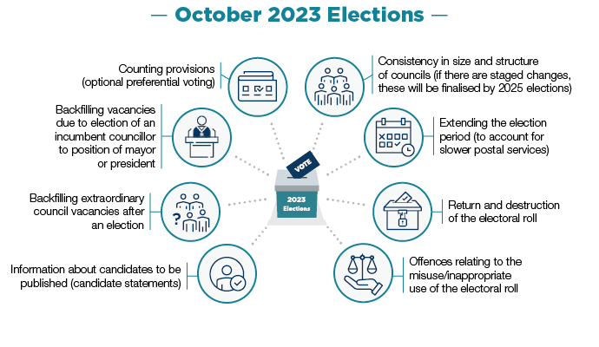

Slide 45
Local Government Act Reform – Tranche Two
November 2023 – Anticipated introduction of Tranche Two bill
Tranche Two will include the introduction of the Local Government Inspector and Monitors
The Inspector will be appointed to handle complaints, manage investigations and coordinate the proactive resolution of significant problems
Specialist independent Monitors appointed by the Inspector and will visit and work with local governments to fix problems and provide faster resolutions

Slide 46
Further information
Department of Local Government, Sport and Cultural Industries
dlgsc.wa.gov.au
Local Government Advisory Line
lghotline@dlgsc.wa.gov.au
Phone: 1300 762 511

Slide 47
James McGovern
Manager Governance & Procurement WALGA
The purpose of Local Government
The role of an Elected Member
Conflicts of Interest

Slide 48
Introduction
Understanding Local Government
Serving on Council
Meeting Procedures
Conflicts of Interest
Understanding Financial Reports and Budgets
Support for Council Members
Notes:
Tonight’s presentations from the WA Electoral Commission and the Department of Local Government, Sport and Cultural Industries will prepare you for your candidacy in the lead up to election day.
In this presentation, we will briefly look at what you can expect should you be successful in your candidacy and be elected as a Council Member.
Those people elected to office will be required to undertake mandatory ‘Council Member Essentials’ training, and tonight’s presentation <<CLICK>> is based on the five core modules read above.
<<CLICK>>
We will close tonight with a brief summary of the support that is in place to assist you as a Council Member.

Slide 49
Understanding Local Government
Council Member Essentials
Notes:
We will start with the Understanding Local Government module, which will assist you in your transition from a private citizen to a Councillor.

Slide 50
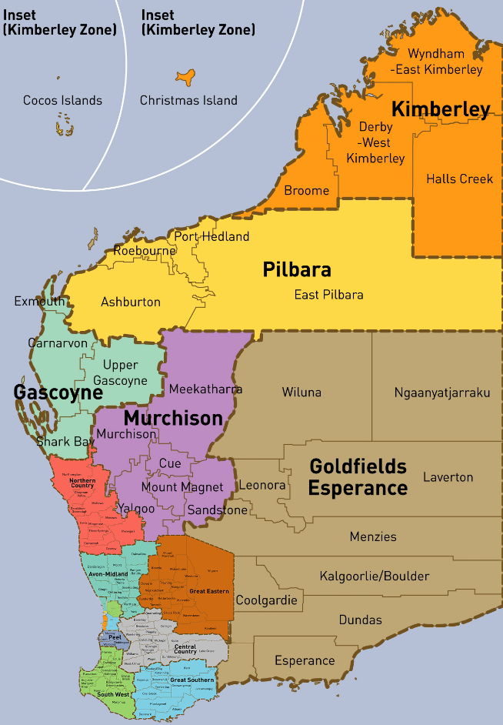
Local Government in WA
139 Local Governments
1,213 Council Members
22,600 Employees
$4.5 billion expenditure
$49 billion assets
88% of public roads
Notes:
Local Government in WA is a big industry.
<<CLICK>>
There are 139 Local Governments with over 12 hundred Council Members representing communities right throughout the State, including Cocos (Keeling) and Christmas Islands. The sector employs over 22 thousand people.
<<CLICK>>
As can be seen, as an industry the sector contributes significantly to the State economy with $4.5 billion dollars in expenditure and management of almost $50 billion dollars in assets.
Bearing in mind its original formation as Roads Boards, it is significant that Local Governments to this day continue to manage the vast majority of the state’s road network.

Slide 51
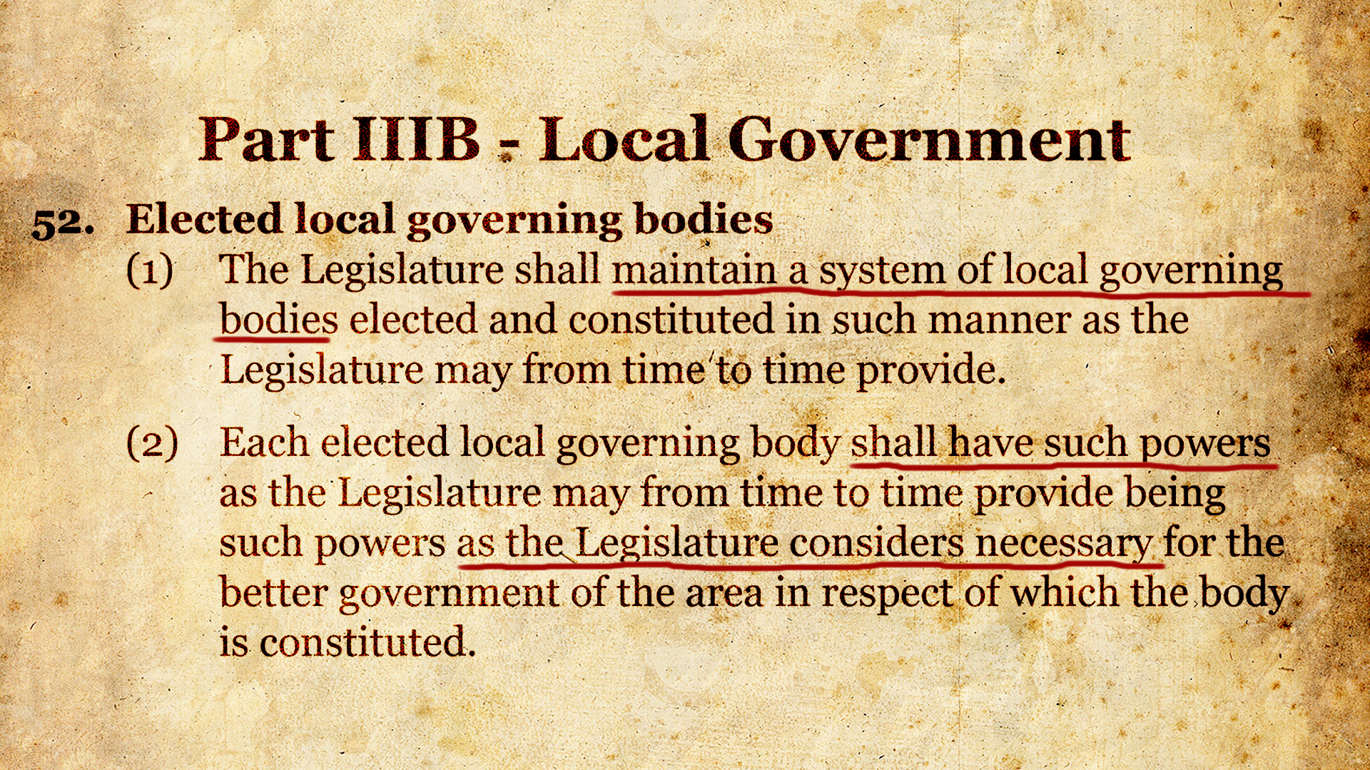
Notes:
Local Governments are created under residual powers retained by the States upon Federation.
The WA Constitution Act requires the State Legislature to maintain a system of Local Government and to provide it with relevant powers.
It is therefore often said that Local Government is a creature of State legislation.

Slide 52
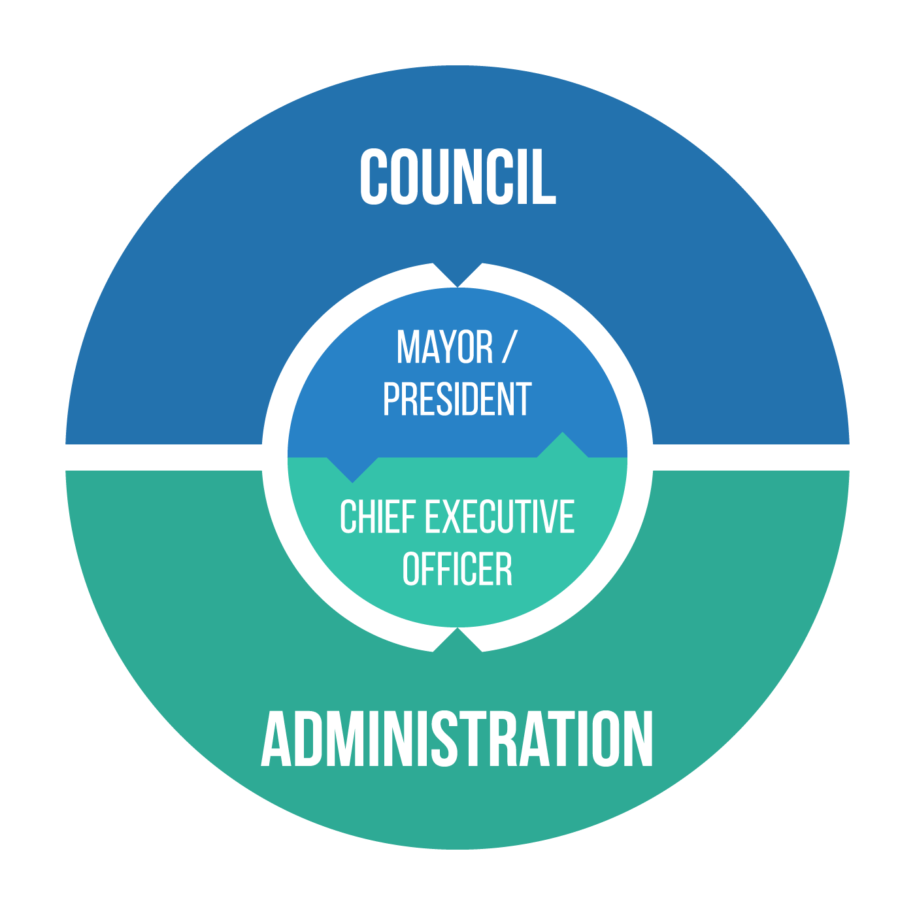
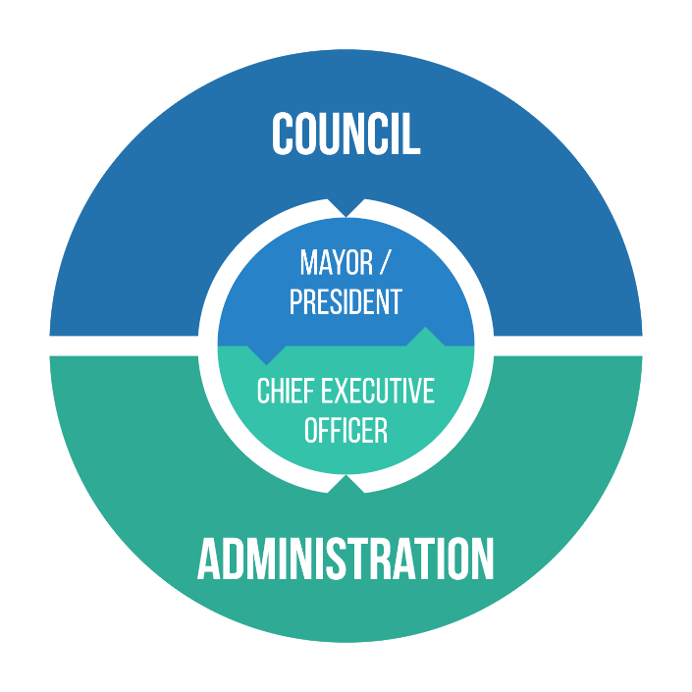
A ‘General Competence’ Act
The Act is a ‘general competence powers’ legislation.
Under general competence powers, a Local Government can make any decision required to provide for good government that are not in conflict with statute law or common law.
Body Corporate
Notes:
We are currently operating under the Local Government Act 1995.
Click
This Act is designed in a way to provide separate roles and responsibilities for the Council, led by a Mayor or President, and the Administration led by a Chief Executive Officer.
Click
The Act is based on the principle of general competence, which means that a Local Government can make any decision it believes is in the best interests of its community but does not conflict with statute law or common law.

Slide 53
People Services e.g. – Libraries, recreational facilities, services for youth, services for the aged, arts and cultural events, community facilities
Property Services e.g. – Local roads, footpaths, parks and gardens, waste services, security services and recycling
Regulatory Services - Land use planning approvals, building permits, swimming pool inspections, animal control, environmental health, parking controls, behaviour in public places
Notes:
The Local Government Act does not specifically set out the services that must be provided but there are many other Acts that do.
For example, planning and building legislation requires Local Governments to perform functions in relation to land use planning, development and building approvals; and perform swimming pool inspections.
Local Governments have wide-ranging discretion to determine other services that it will provide to the community, which typically include recreational services and facilities; and arts and cultural functions and events.
The range of mandatory and discretionary services provided by Local Governments is generally categorised as People Services; Property Services and Regulatory Services.

Slide 54
Serving on Council
Council Member Essentials
Notes:
We will now look at Serving on Council and the legislated provisions that establish separate roles and responsibilities between the Council and the Administration.

Slide 55
Separate Powers
The following extract from the Second Reading Speech for the Local Government Act 1995 provides insight to the purpose and intent of legislating for separate powers:
“The new Act will provide a clear distinction between the representative and policy making role of the elected Councillors and the administrative and advisory role of the Chief Executive Officer and other staff.”
Consequently, clear distinctions are established between the roles and responsibilities of the Council and those of the administration throughout the Local Government Act.
Notes:
When considering roles and responsibilities it is important to bear in mind that the Local Government Act was created with separate powers in mind. We see this intent in the following reading speech extract when the current Act was read into Parliament << CLICK >>
The new Act will provide a clear distinction between the representative and policy making role of the elected Councillors and the administrative and advisory role of the Chief Executive Officer and other staff
CLICK
We will now look at how the Act was quite deliberately written with distinct roles for the Council, represented by Council Members, and roles for the Administration led by the CEO.

Slide 56
Role of Council
The Council
governs the local government’s affairs;
is responsible for the performance of the local government’s functions;
oversee the allocation of the local government’s finances and resources; and
determine the local government’s policies.
Notes:
The Act provides that it is the role of Council to govern the Local Government’s affairs and that it is responsible for the performance of the Local Government’s functions. Further, it is to oversee the allocation of the Local Government’s finances and resources (most significantly when adopting the annual budget) as well as determining the policies of the Local Government.

Slide 57
Role of Councillor
A councillor —
(a) represents the interests of electors, ratepayers and residents of the district; and
(b) provides leadership and guidance to the community in the district; and
(c) facilitates communication between the community and the council; and
(d) participates in the local government’s decision-making processes at council and committee meetings; and
(e) performs such other functions as are given to a councillor by this Act or any other written law.
Councillors do not have specific individual powers but, when working together with fellow Council Members, provide an invaluable service to their community.
Notes:
Here is a description of the role of a Councillor incorporating representative; leadership; communication; and decision-making roles.
<< CLICK >>
The Local Government Act does not provide Councillors with individual powers.
We will take a closer look at the role of a Councillor soon by bringing to life some of these roles.

Slide 58
Role of Mayor or President
(1) The mayor or president —
(a) presides at meetings in accordance with this Act; and
(b) provides leadership and guidance to the community in the district; and
(c) carries out civic and ceremonial duties on behalf of the local government; and
(d) speaks on behalf of the local government; and
(e) performs such other functions as are given to the mayor or president by this Act or any other written law; and
(f) liaises with the CEO on the local government’s affairs and the performance of its functions.
The Mayor or President has one specific individual power, authorising unbudgeted expenditure in response to an emergency.
Notes:
The Mayor or President has additional roles that relate to the leadership of Council and the community << read >>.
<< CLICK >>
Mayors and Presidents have one important individual power, authorising unbudgeted expenditure in response to public emergencies and natural disasters.

Slide 59
Functions of the Chief Executive Officer
Advise Council on the functions of LG
Provide advice and information to Council
Implement Council decisions
Manage the day-to-day operations of the LG
Liaise with Mayor or President on LG’s affairs and performance
Speak on behalf of the LG with the consent of Mayor or President
Employment, management supervision, dismissal of employees
Notes:
Here are the functions of the Chief Executive Officer, who leads the Administration << CLICK THROUGH >> .
Notice how these functions are operational in nature, as compared to the Council’s governing and strategic role and the Councillors representative and decision-making role. These functions can only be performed by the CEO, or by the professional staff under the direction of the CEO.

Slide 60
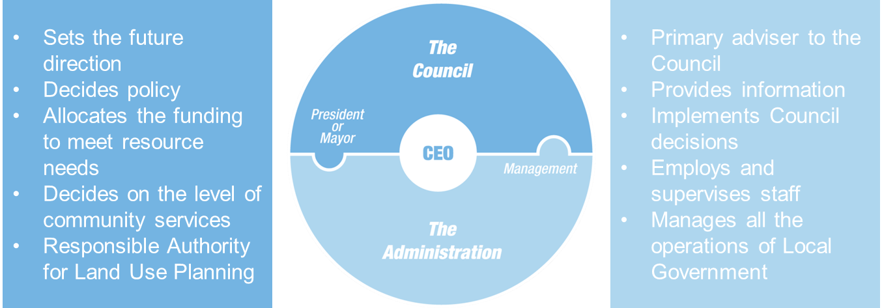
Separate Powers
Local Government
Body Corporate
Council
CEO
Notes:
Understanding and observing the separate roles and responsibilities is fundamental to a Local Government providing efficient and effective governance.
In practice, whilst the two sides of the Local Government – the Council and the Administration led by the CEO – perform separate roles but do so collaboratively to deliver great outcomes for their community……
CLICK
….and the collective outcomes from the Council and Administration working together will happen in the name of the Local Government, which is a legal entity established as a body corporate.

Slide 61
Playing your role on Council
A councillor —
(a) represents the interests of electors, ratepayers and residents of the district; and
(b) provides leadership and guidance to the community in the district; and
(c) facilitates communication between the community and the council; and
(d) participates in the local government’s decision-making processes at council and committee meetings; and
(e) performs such other functions as are given to a councillor by this Act or any other written law.
Notes:
Now let’s go back to the role of a Councillor and bring to life the way in which you will perform these highlighted roles.

Slide 62
Declaration by elected member of council
Declaration by elected member
I, .........................................................................................................................................
of ¹ .....................................................................................................................................,
having been elected to the office of ²mayor/deputy mayor/president/deputy president/councillor of the³ ..............................................,
declare that I take the office upon myself and will duly, faithfully, honestly, and with integrity,
fulfil the duties of the office for the people in the district according to the best of my judgment
and ability, and will observe the code of conduct adopted by the ³ ...........................
under section 5.104 of the Local Government Act 1995.
Notes:
Represents the interests of electors’ ratepayers and residents of the district.
If you are elected to Council, the first duty you will perform before serving in office will be the signing of this declaration.
By signing this declaration, you are pledging a commitment to represent the interests of all people in the district – faithfully, honestly and with integrity - through your office on Council and that you will observe the Code of Conduct in doing so.

Slide 63
Community Member requests an Council Member to respond to:
Works Request, Complaint or Concern regarding the Local Government’s operations.
“Thank you for informing me, I will refer this to the Administration and you will hear directly from them.”
Council Member
Council Member informs Administration through communication protocol
Administration
Notes:
Facilitates communication between the community and the council
If you are elected it is very likely that you will receive direct communications from residents, by phone, by email and when meeting people in the community.
Here is a good example of a Councillor receiving an enquiry that relates to an operational matter – it could be a pothole in the road; a broken swing at the playground; or a barking dog.
We now know that operational matters are the function of the CEO and the administration.
<< CLICK >>
Here we see the Council Member doing the right thing by providing good advice to the community member, and << CLICK >> the administration takes care of the matter.

Slide 64
Typically, most meetings deal with:
Policy and Strategy;
Dealing with development applications;
MAYOR / PRESIDENT
Major Projects;
Annual budget and monthly financial management reports;
Range, scope and delivery of services; and
Monitoring performance and compliance.
If present at a meeting you must vote
Notes:
Participates in the local government’s decision-making processes at council and committee meetings << CLICK >>
Arguably the most important role a Councillor plays is that of a decision-maker at formal Council meetings. Listed here is a range of typical matters dealt with at each Council meeting.
Your decision-making function is so important << CLICK >>that the Local Government Act states that all Council Member who are present at a meeting must vote.
This takes us to the next module of Council Members Essentials << CLICK >>

Slide 65
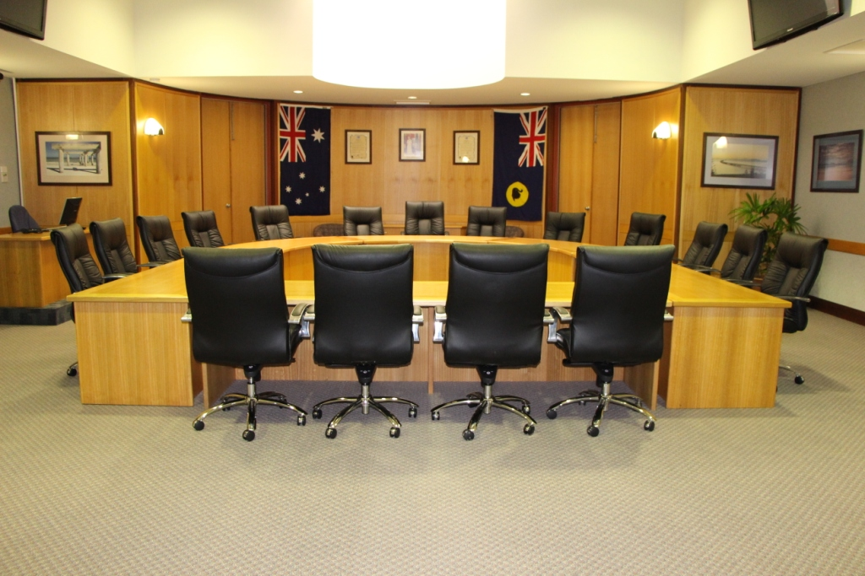
Meeting
Procedures
Council Member Essentials

Slide 66
Council Meetings
Notes:
There is much to understand about meetings of Council, where your important decision-making role occurs. Your own personal and professional experiences, including your employment history; educational qualifications and any additional skills you may bring to the role such as experience on Boards and Committees, will provide an invaluable background to your life as a decision-maker on Council.
The Meeting Procedures module will provide comprehensive information on the life-cycle of decision making including; the development of the Agenda which includes detailed reports and recommendations by professional staff under the direction of the CEO; the assistance provided to Council Members by the Administration before formal meetings to answer any questions they may have; and the protection of the rights of all Council Members to participate equally in a meeting, have their voice heard in debate and contribute to the decisions made by Council.

Slide 67
Laws Applying to Meetings
Notes:
Council meetings are subject to a considerable range of provisions in the Local Government Act, the associated Regulations and in Meeting Procedures Local Laws.
There is a particular focus in legislation on the rights of the community to be involved in Council meetings. For example:
The public have a right to attend meetings and the beginning of every Council meeting is set aside for Public Question Time;
Local Governments will soon be required to live broadcast or audio record their meetings, creating a permanent public record;
The public have a right to access the Agenda before the meeting, and to access Minutes resulting from Council meetings;
The public can even call a special meeting of electors, where they can raise one or more matters for Council’s attention.
In the very near future, all Local Governments will conduct meetings under a single Uniform Meeting Procedures regulation, rather than individually adopted Local Laws.

Slide 68
Model Code of Conduct
At Council or Committee Meetings:
Must not act in abusive or threatening manner
Must not make false or misleading statement
Must not repeatedly disrupt the meeting
Must comply with local law
Must comply with direction of person presiding
Must cease conduct that has been ruled out of order
Notes:
The Local Government Act provisions relating to meetings are not just about procedures.
New Code of Conduct provisions seen here, have introduced new behavioural requirements for individual Council Members at Council and Committee meetings
This heightened level of accountability means it is of great importance that Council Members fully understand there are expectations of appropriate behaviours at formal Council and Committee meetings.
Abiding by the Code is not only an ethical obligation, given that any behavioural failure that breaches the Code may result in a complaint.

Slide 69
What do you think?
True or False?
At a Council meeting, I can exercise my freedom of speech and make any comment that I wish?
Notes:
Let’s close this module with a quick quiz << READ >>

Slide 70
Qualified Privilege
At a Council meeting, I can exercise my freedom of speech and make any comment that I wish?
An important principle applying to Local Government Council
meetings is one of Qualified Privilege.
Absolute Privilege
As opposed to Parliamentary Privilege, a Council Member has limited defences should they be the subject of a claim for damages based on alleged defamatory statements associated with their role on Council.
Qualified Privilege
Notes:
This is of course, false…..
<< Summarise Above Notes >>

Slide 71
Conflicts of Interest
Council Member Essentials
Notes:
As we have seen, one of the most important functions you will perform in your time on Council is that of a decision-maker.
But the Local Government Act also includes limitations which, if they apply to you, will exclude you from being present at formal meetings and from voting. These matters are covered in the Conflicts of interest module.

Slide 72
Declaring Interests
Financial
Indirect Financial
Proximity
Impartiality
s 5.60A
s 5.61
s 5.60B
Code of Conduct cl.22


Participate & Vote:
Participate & Vote:
Notes:
Categories of conflicts of interest are:
Financial Interest : is where you have an interest in a matter before Council involving a financial gain, benefit, loss or detriment
Indirect Financial Interest : is where you or a person with whom you are closely associated has an interest in a matter before Council
Proximity Interest : is where you have an interest in land that adjoins any land subject of a planning, zoning or development matter before Council.
Impartiality Interests : Is an interest you in a matter before Council due to kinship, friendship or membership of an association.
The Act directs that where you have a Financial, Indirect Financial or Proximity Interest << CLICK >> you cannot participate or vote on that matter in which you have declared an interest. You will have to leave the Council Chamber prior to the commencement of debate.
Conversely, declaring an impartiality interest <<CLICK>> does not have the same consequence – you stay in the Council Chamber, debate and must vote on the matter.

Slide 73
Notes:
It is appreciated that you might wear many hats in your local community.
Our advice is that you should always consider your obligations to declare interests from the perspective that you are always a Councillor. You should guard against attempting to separate your private interests from your role in public office when considering conflicts of interest.

Slide 74
Understanding Financial Reports and Budgets
Council Member Essentials
Notes:
The Understanding Financial Reports and Budgets module provides a detailed summary of the strategic planning process of Local Government, and the integration of Council Plans into the annual budget and the regular financial reporting process.

Slide 75
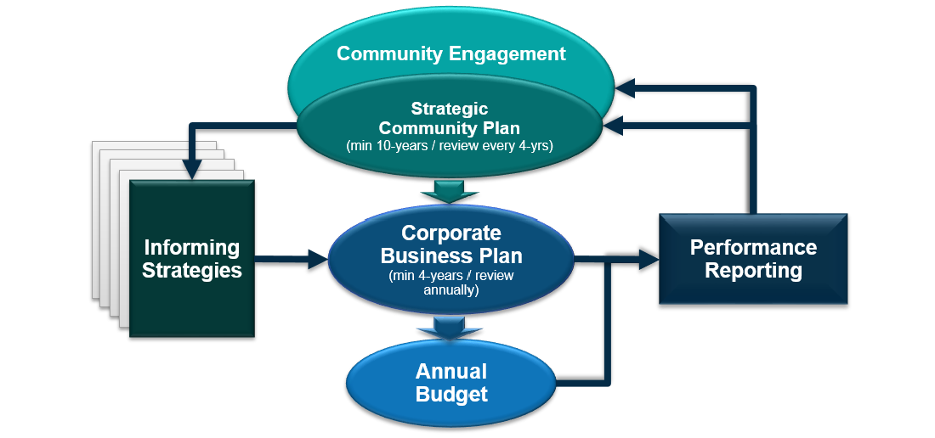
Council Plans
A robust strategic planning framework is at the foundation of the purpose of Local Government and aligns with its statutory function of ‘providing for the good government of persons in the district.’
Council Plans:
ensure community input is reliably generated to inform the medium to long term objectives of the Local Government;
are developed to meet specific objectives and measurable outcomes;
identify the resourcing required to deliver the plans; and
enable rigorous, achievable and transparent prioritisation within available resources of the Local Government.
Notes:
A Council Plan, currently referred to as the Strategic Community Plan, is a foundation for modern Local Government providing the structure by which Local Governments strategically plan for their community’s needs.
<< CLICK >>
A robust strategic planning process is central to a Local Government meeting its statutory function - providing for the good government of persons in the district

Slide 76
Council Plans
Notes:
A Council Plan is multi-faceted and includes a range of informing strategies that are relative to the unique nature of each Local Government. Council Plans are therefore not ‘one size fits all’ and there is great variety from one Local Government to the next.
The output is a Council Plan process is the 4 year Corporate Business Plan, and this directly informs a Local Government’s annual budget process.
Council Plans are not set and shelved; there is a regular cycle of review and renewal which ensures the Plan remains aligned to community expectations.

Slide 77
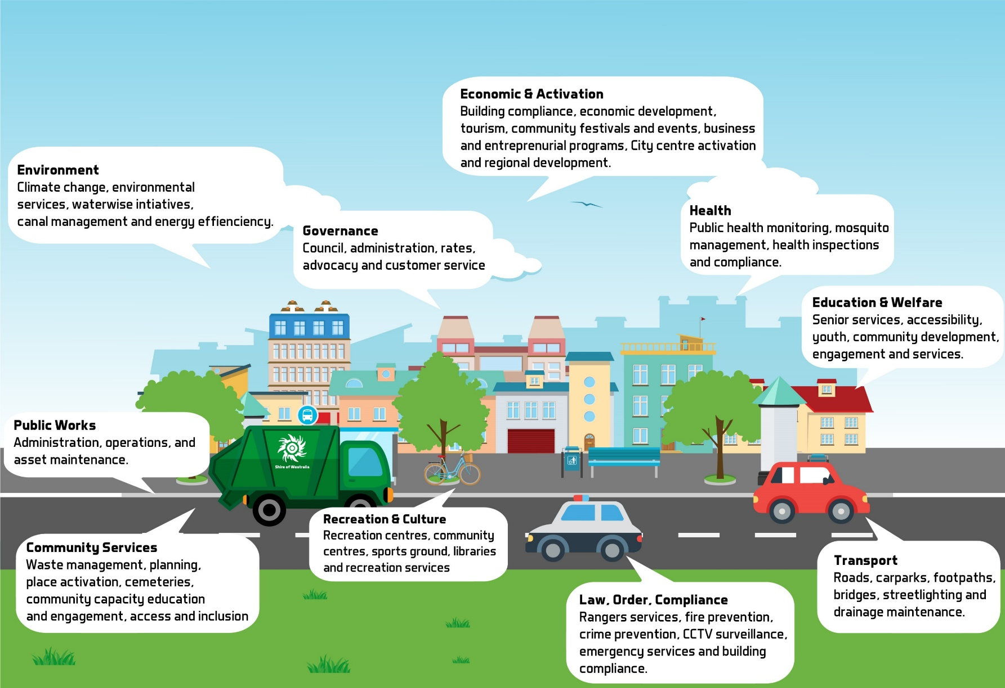
Notes:
Earlier, we had a quick look at the variety of mandatory and discretionary services provided by Local Governments.
The Council Plan is the process that solidifies the strategic service delivery objectives of the Local Government and enables all services to be properly planned and resourced.

Slide 78
Support for Council Members
Council Member Remuneration
Reimbursement of Expenses incl. Child Care
New Parental Leave Provisions
Enhanced Professional Development Policy
Proposed Council Member Superannuation
Notes:
We will now look at the support that is provided to Council members.
There are many ways that Local Government legislation supports Council Members < CLICK >
The WA Salaries and Allowance Tribunal determines a range of meeting fees or annual allowances payable to Council Members, to remunerate for the time you spend on Council << CLICK >>
The Local Government Act permits reimbursement of expenses incurred in your role, including childcare costs incurred due to attendance at meetings (which recently increased to $35 per hour) << CLICK >>
New parental leave provisions entitle Council Members to 6 months leave where they or their spouse or de facto partner gives birth, adopts of fosters a child << CLICK >>
New provisions allow payment of fees for attending mandatory training and continuing professional development, plus reimbursement of related expenses, under a Policy adopted by Council << CLICK >>
And finally, the Minister for Local Government plans to introduce the payment of superannuation to Council Members, in a future amendment to the Local Government Act.

Slide 79
Notes:
That brings to a close this presentation, thank you for attending and we will now answer some of the questions raised this evening.

Slide 80
Tony Brown Executive Director of Member Services WALGA
Questions?

